Slide 1

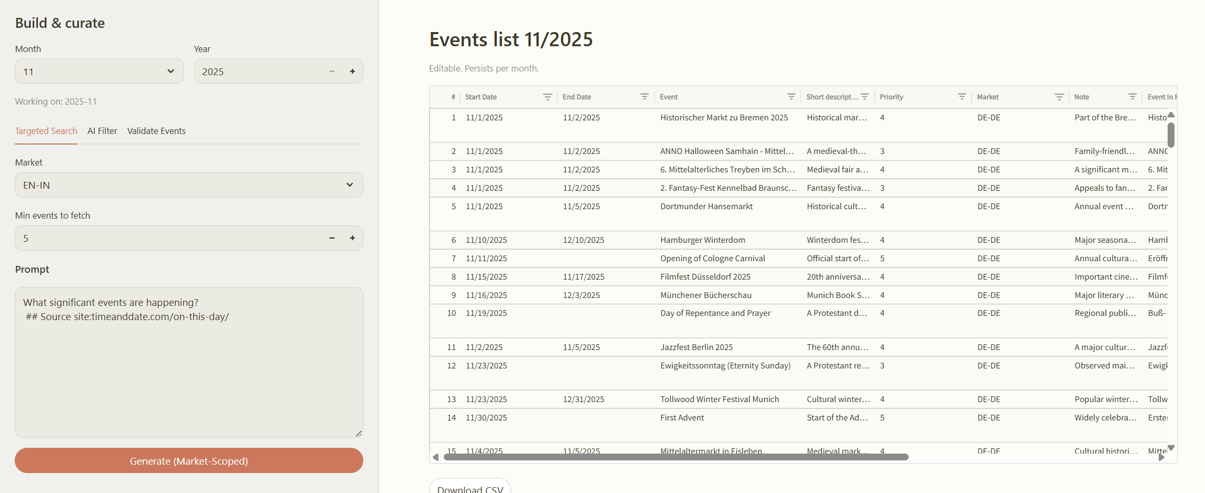
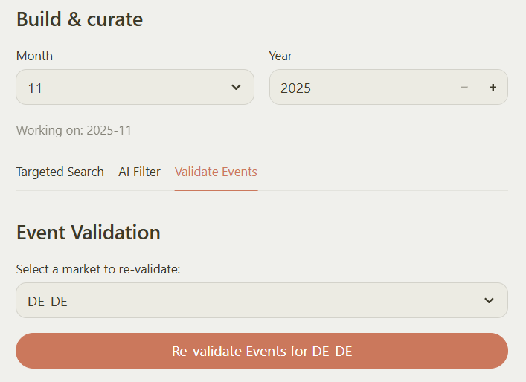
Microsoft– Agentic AI Event Automation
Business Need
The client’s team was spending significant time manually collecting, verifying, and prioritizing event data across markets. This process relied on manually navigating event calendar URLs, using Bing/Google searches, and maintaining Excel sheets — leading to inconsistent data quality, limited scalability, and low efficiency.
What we Did
Affirma designed and implemented an automated event intelligence solution that:
Crawled target URLs to automatically capture event data
Leveraged search APIs to supplement event listings with additional sources.
Used Azure OpenAI to enrich, summarize, and generate structured event outputs in Excel.
Applied historical data and AI-based logic to auto-assign event priorities.
Enabled optional chatbot interaction to quickly query events and related metadata.
Results
80% reduction in manual effort and data preparation time.
Improved accuracy and consistency across all market event lists.
Centralized repository of both upcoming and historical events for analytics.
AI-powered insights enabled better event planning and prioritization.
Enhanced user experience with an optional chatbot interface for instant event data access

